Slide 1
Team MSVG
Care4U
Sandesh Bansal: 73002-50160
Maharshi Vashishta: 63771-13804
Vanshika Sood: 62309-97037
Garima Gupta: 89496-28744

Slide 2
Description of the Project
Problem Statement
Approach to the Solution
Increase awareness of your overall health and wellness during menstrual cycle.
.
Started with research on menstruation and developing a tracker, and adding information from verified sources
Relevance to the Theme
Techstack Involved
The endless limits of open innovation shelters the project.
Used the basics of Web development i.e. HTML, CSS, JS.

Slide 3
Details of Technology Stack
JS
The brain of the website, decides the functioning of different elements of the same.
CSS
Beautifying the website using cascading style sheets
HTML
The basic skeleton of the website created.

Slide 4
Description of the Solution
Step 1
Step 2
Researched about menstruation and gathered information from verified sources.
Used the basics of HTML to construct a static website.
2021
Step 3
Step 4
Added relevant images and used CSS to beautify the website.
Linked a period tracker created using basic javascript/

Slide 5
Novelty of the Solution
Menstruation has always been surrounded by taboos and myths that exclude women from many aspects of socio-cultural life. We want to challenge these beliefs, bust the myths and remove the stigma surrounding the same.
Menstrual tracker helps women feel more in control of their health through awareness and education about their cycles and bodies.
Our projects provides a minimalistic and easily accessible approach for the same and provide, a menstrual tracker, tips, advice from various verified sources, and answer frequently asked questions.
In modern times it is essential to remove the stigma associated with menstruation and make it part of our daily conversations

Slide 6
Growth Plan of the Product
10%
Designing the basic outlook of the website and research for the solution.
Checkpoint 1
25%
Designed the basic structure of the website and got in touch with the professionals working in this field
Checkpoint 2
60%
Beautified the website and made it aesthetically pleasing retaining its ergonomic capabilities.
Checkpoint 3
90%
Designed the Period Tracker and Linked the multiple pages and other handles associated with the team and the project.
Checkpoint 4

Slide 7
Business Aspects of the Hack
01
Market Impact
Provides a user friendly and easily accessible platform to track periods and garner more information about menstruation.
Target Consumers
02
Anyone who menstruates and others who wish to learn about it.
03
Financial Sustainability
Using the google adsense revenue system to stabilize the product in the market with future ideas of subscription system
Product > Project
04
With the continuous efforts on the project it can be deployed in the market .

Slide 8
Social Impact
Historically people haven’t wanted to talk about menstruation as it’s been deemed an area of significant embarrassment. The first thing, we want to achieve is to get the conversation going.
As menstruation has always been a taboo and stigmatic topic women and girls have been missing out on various socio-cultural activities, ranging from not being able to schools and offices and not being able to attend social and religious gatherings.
Due to lack of proper knowledge period related disorders have become common and in some cases they turned out to be life threatening, we wish to reduce such situations by spreading awareness and making people understand the importance of talking about menstruation.

Slide 9
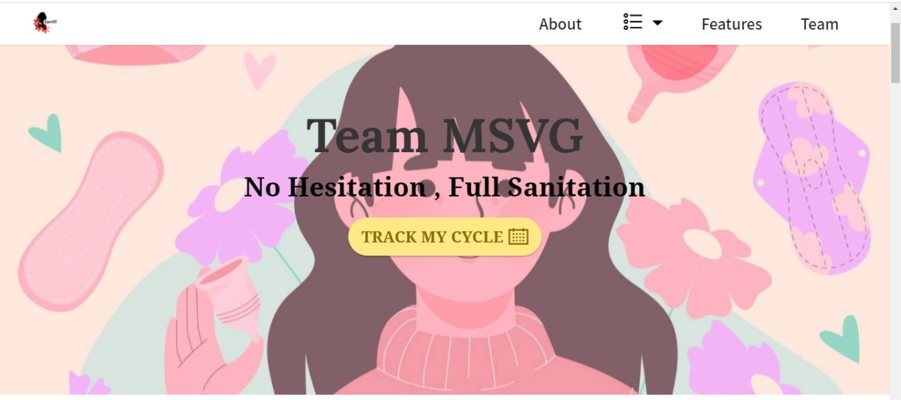
Care4U

Slide 10
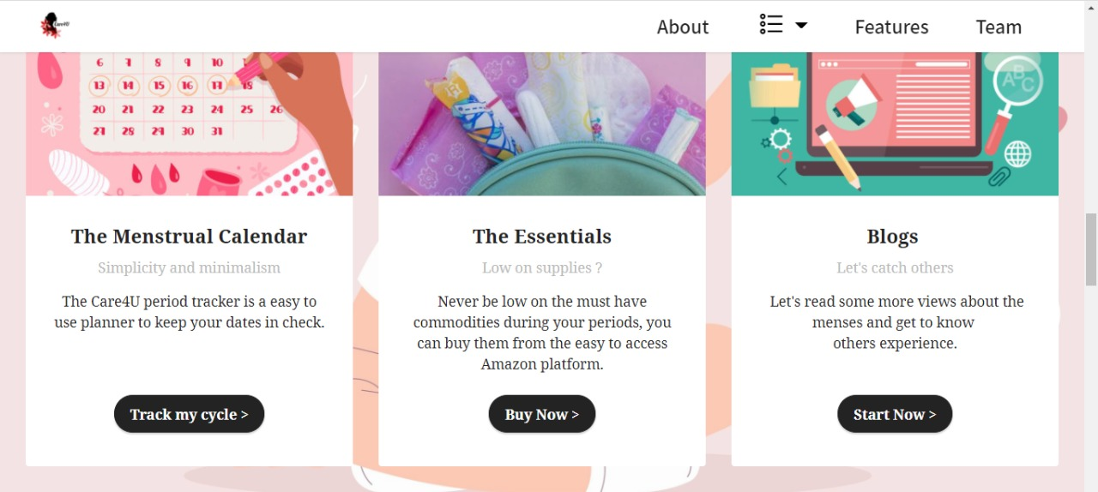
FEATURES

Slide 11
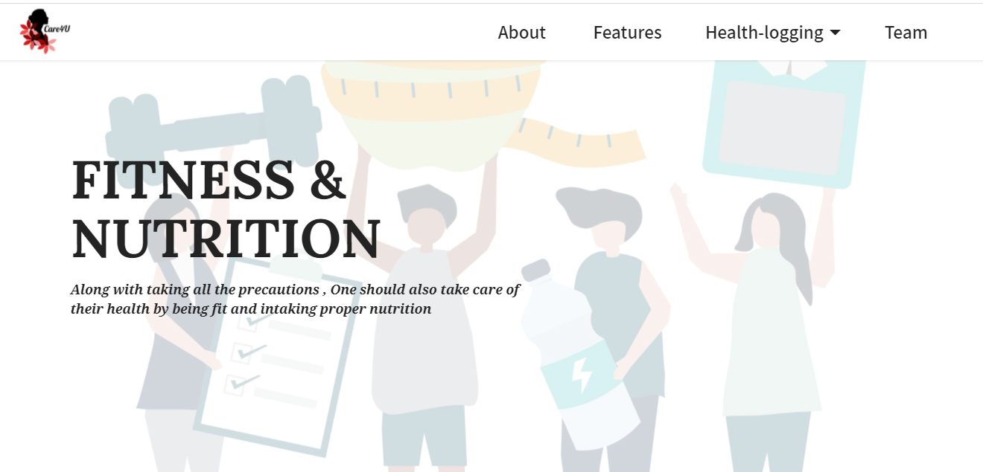
FITNESS & NUTRITION

Slide 12
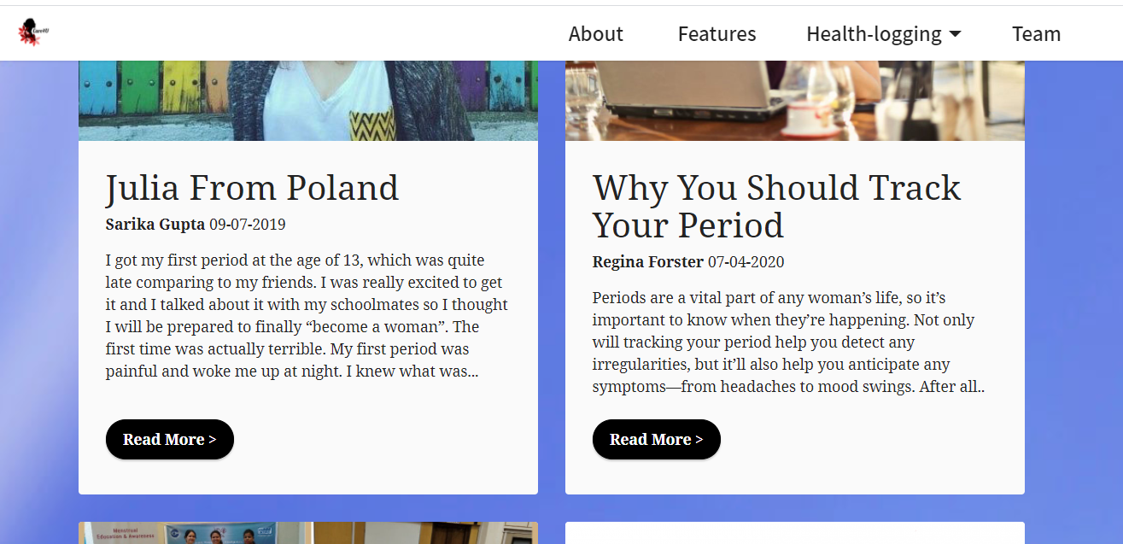
BLOGS

Slide 13
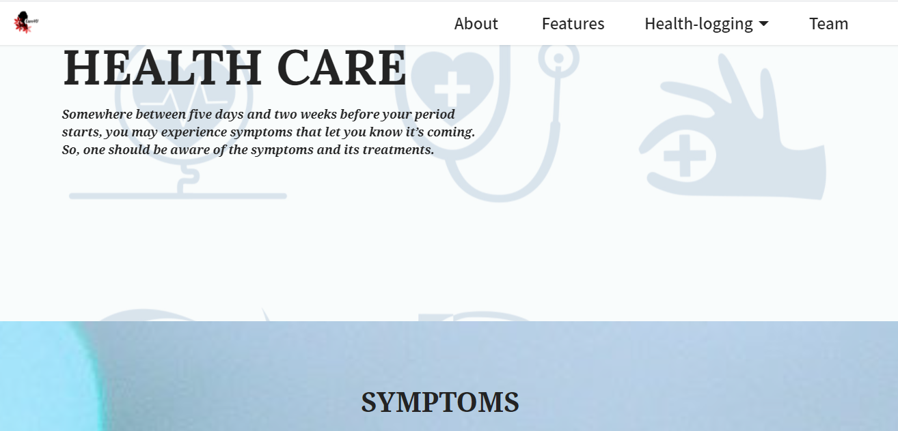
HEALTH CARE

Slide 14
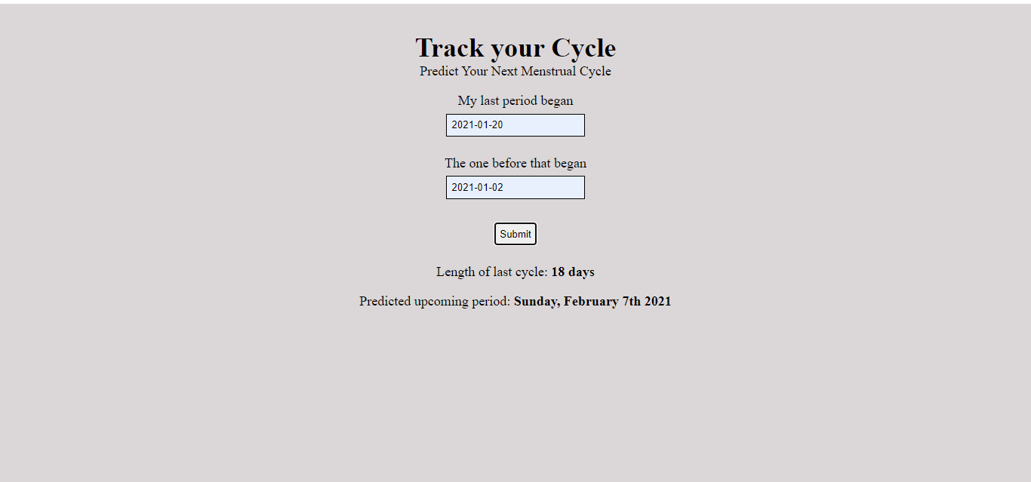
LIVE TRACKER

Slide 15
Learning Curve
04
01
Growth 1
Understand the use of different types of tags in HTML5 and how to link images on local drive through img tag.
03
02
Growth 2
02
Learned more about menstruation and problems that people face due to lack of facilities.
01
03
Growth 3
The various uses of attributes, selectors, and other various components of CSS and basic use of JS.
04
Growth 4
Learned the importance of teamwork and having good communication and responsibility.

Slide 16
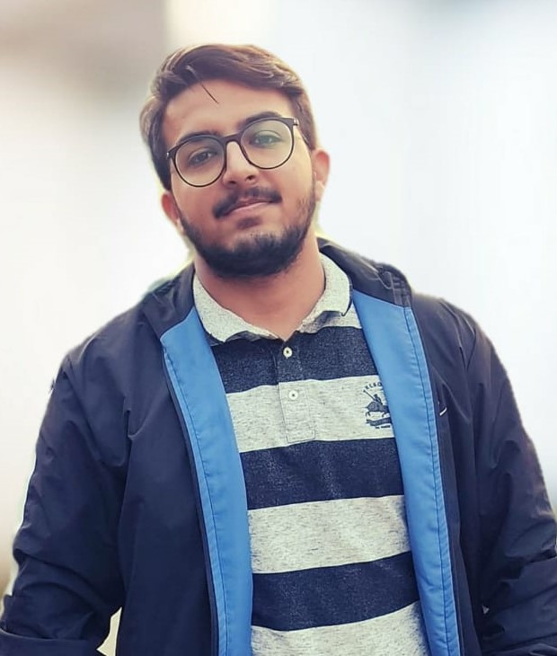
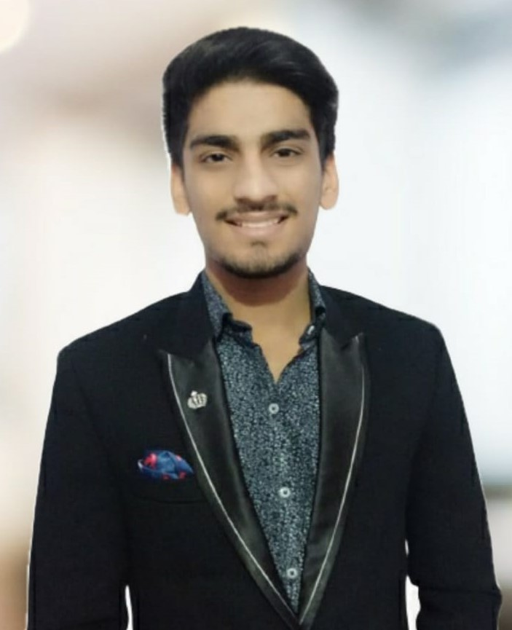
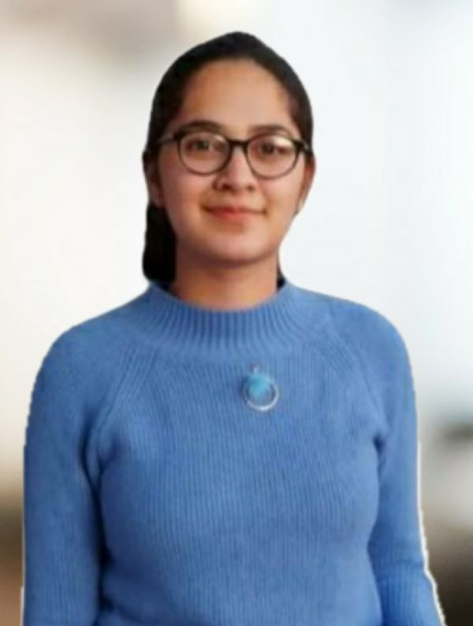
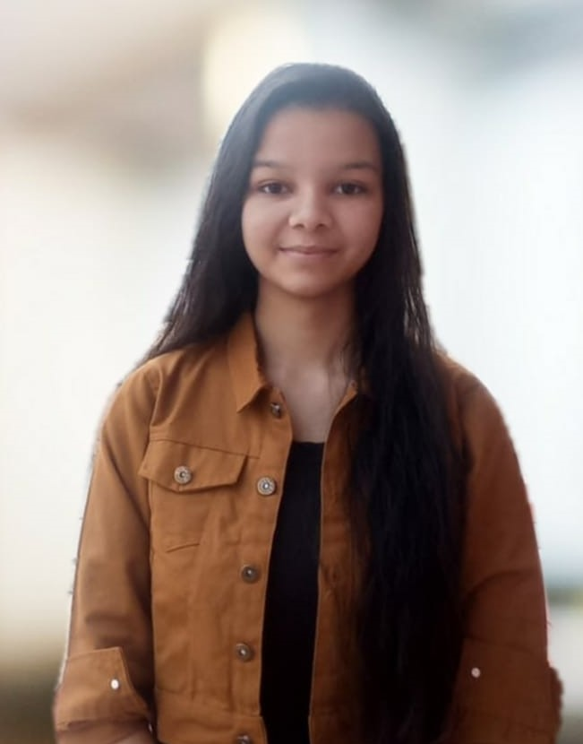
About Team
01
02
MAHARSHI
VASHISHTA
SANDESH
BANSAL
CSE,1st YEAR
CSE,1st YEAR
03
04
VANSHIKA
SOOD
GARIMA
GUPTA
CSE,1st YEAR
CSE,1st YEAR

